Slide 1
STM32 Training IoT Module
August, 2021

Slide 2
Giới thiệu
MQTT Protocol Stack
ESP-LINK Integration
Setup Mosquitto Broker
Setup MQTT Client Box
SLIP Protocol

Slide 3
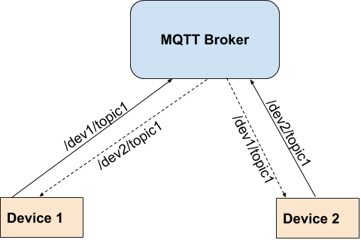
MQTT Protocol
MQTT = Message Queuing Telemetry Transport
MQTT is built on-top TCP/IP Stack (UDP, TCP, Websocket)
Message Queuing = hàng đợi gói tin
Telemetry: collect sensor data / remote control
MQTT | HTTP
Sleep Device (Async – PUB/SUB) | Always-on Device (Sync REQ-REP)

Slide 4
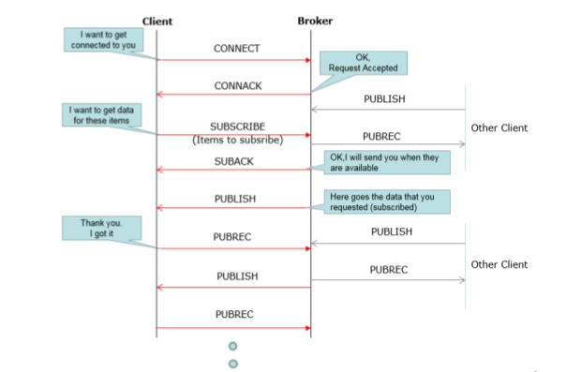
MQTT - Message Flow

Slide 5
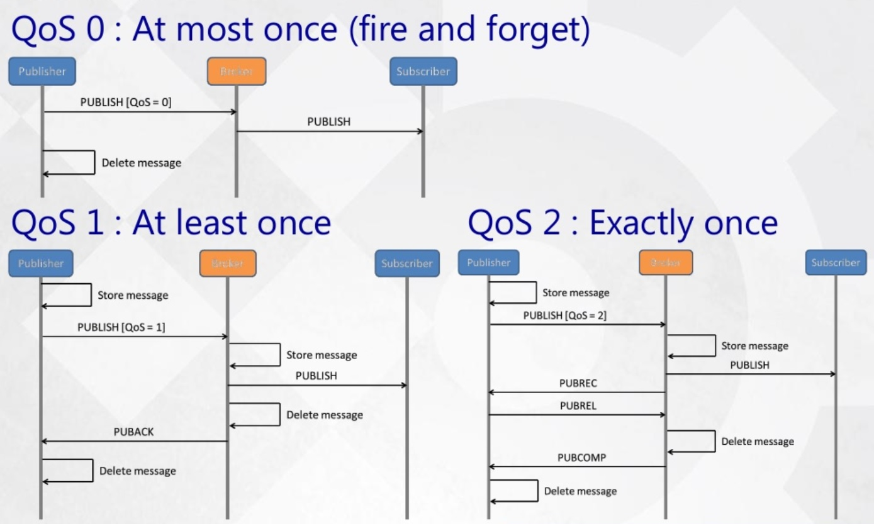
MQTT - QoS (Quality of Service)

Slide 6
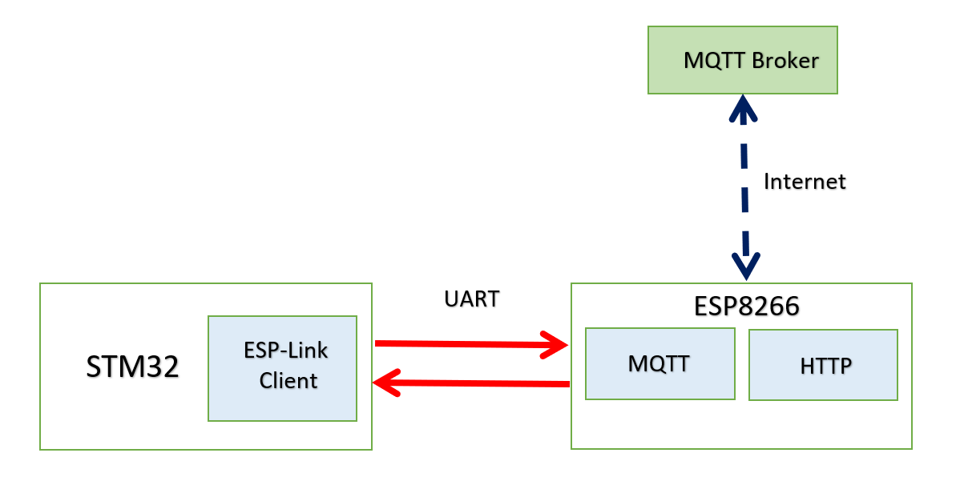
ESP-LINK STM32 Integration
Note: dùng riêng dây usb cấp nguồn cho ESP + nối thêm dây bus GND)

Slide 7
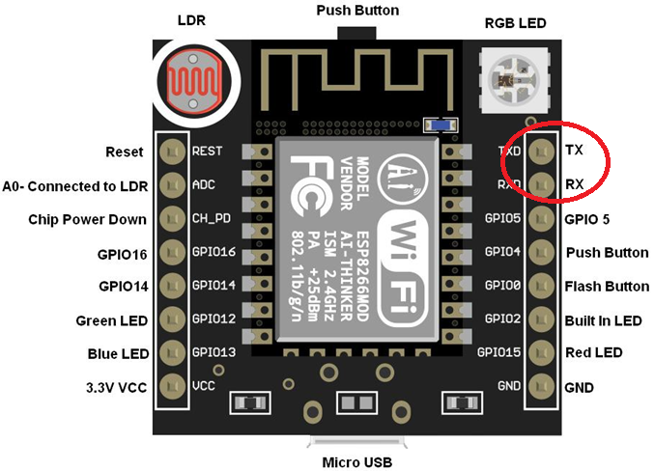
ESP Module

Slide 8
ESP-Link Firmware
ESP-Link
https://github.com/jeelabs/el-client
Prequisite:
- Python 3 (3.7, 3.8, 3.9)
- Install esptool.py
python .\setup.py build
python .\setup.py install
OR
pip install esptool

Slide 9
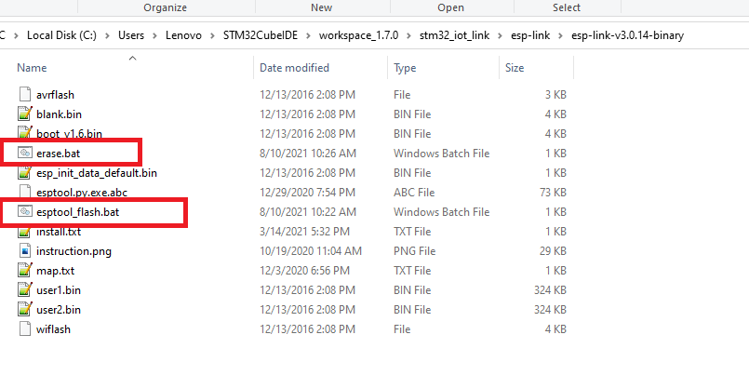
Command line tool
Edit COM Port
esptool.py --port COM14 erase_flash

Slide 10
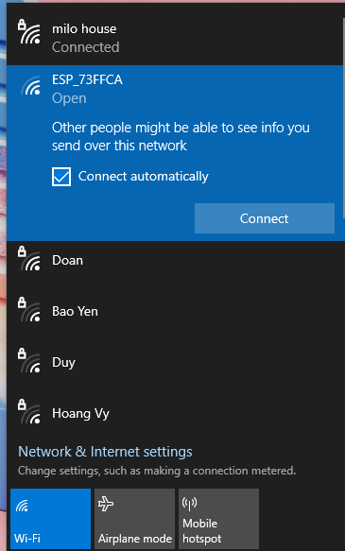
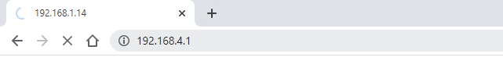
ESP-Link: Setup Wifi
Step 1: join ESP AP Wifi – press Connect
Open Browser ESP’s IP:
192.168.4.1

Slide 11
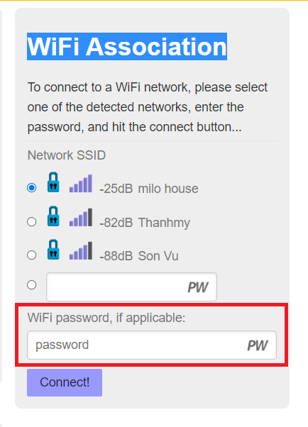
Setup Station Mode

Slide 12
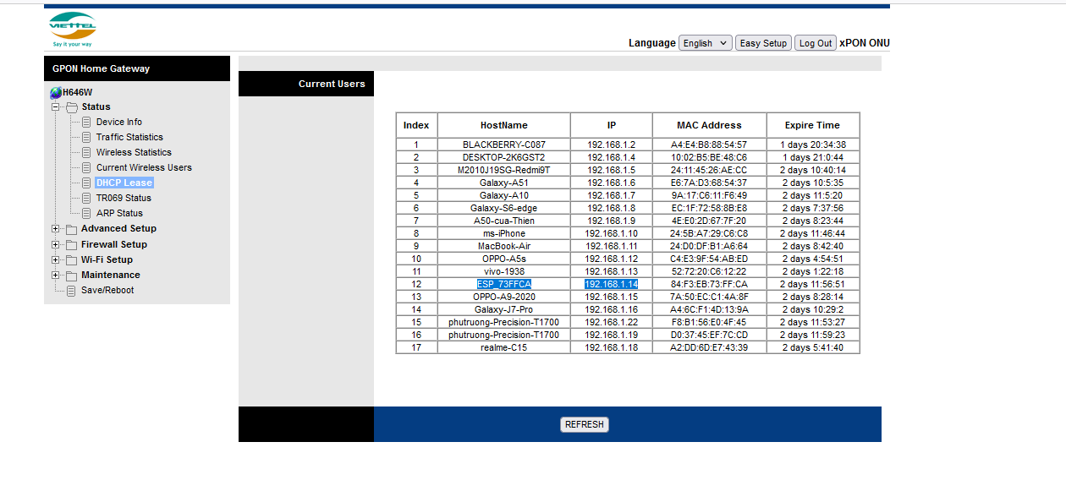
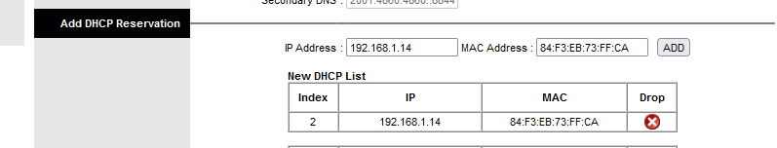
Modem setting

Slide 13
Tool:
MQTT Box
MQTT.fx
Terminal:
MobaXTerm
H-Term
Hercule

Slide 14
WiFi Module (SoC = MCU + WiFi)
ESP32
Murata
Microchip
China: asiancom

Slide 15
RTOS
MAC = Physical
LWIP = Middleware
FreeRTOS
RT-Thread

Slide 16
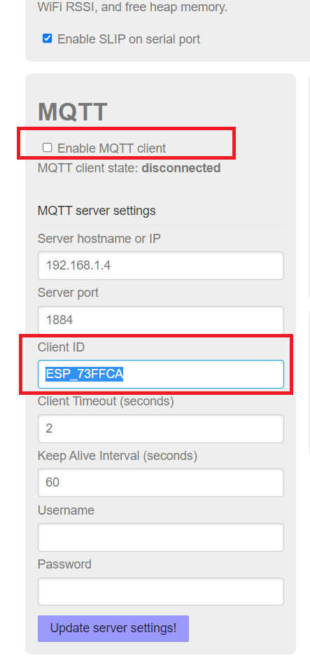
Setup MQTT Link
Reboot after changes

Slide 17
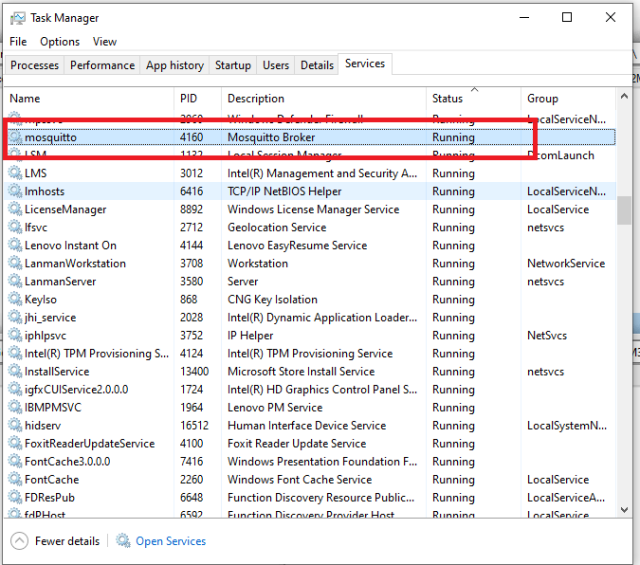
Cài đặt MQTT Broker
Chú ý: Mở Task Manager, tìm server “mosquito” sau đó click chuột phải, nhấn Stop trước khi chạy.

Slide 18
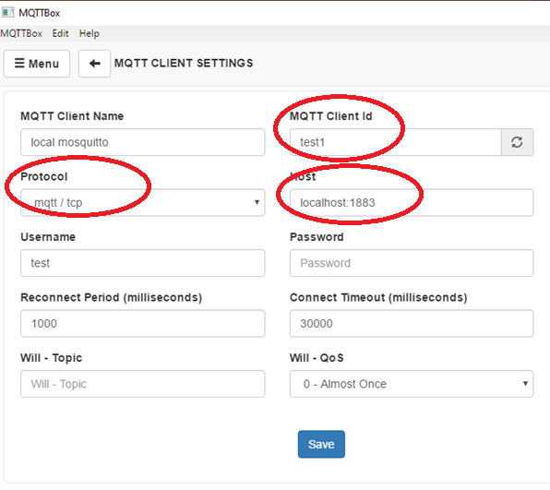
Cấu hình MQTTBox
127.0.0.1:1884

Slide 19
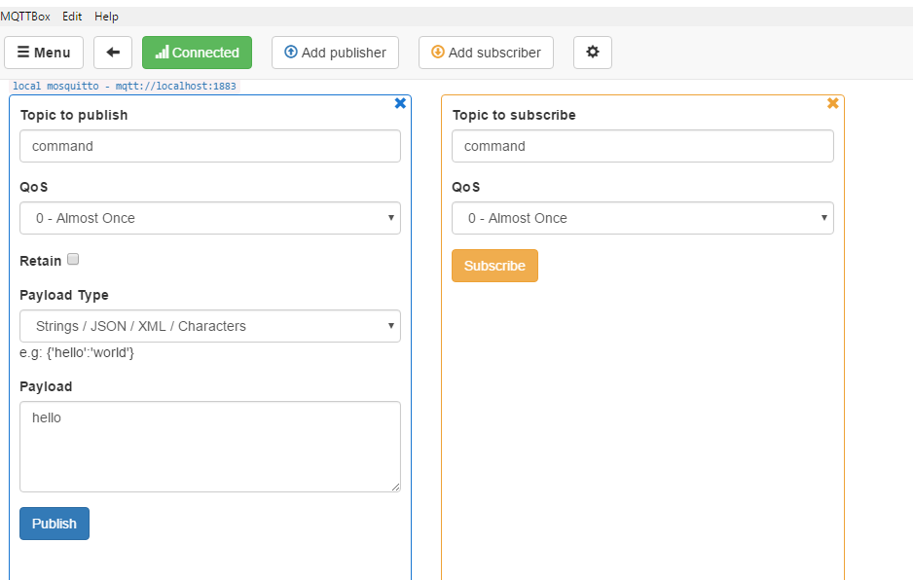
Pub/Sub dùng MQTTBox
Chú ý:Các client phải cùng publish/subscribe trên cùng 1 topic name mới có thể gửi/nhận dữ liệu với nhau.

Slide 20
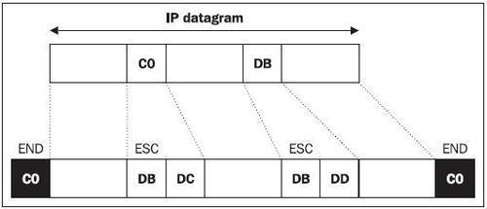
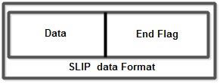
SLIP Protocol (1)
SLIP = Serial Line IP
Break an IP datagram into bytes
Send the END character after the last byte (before the first byte as well)
Replace any data byte “C0” with “DB DC”
Replace any data byte “DB” with “DB DD”

Slide 21
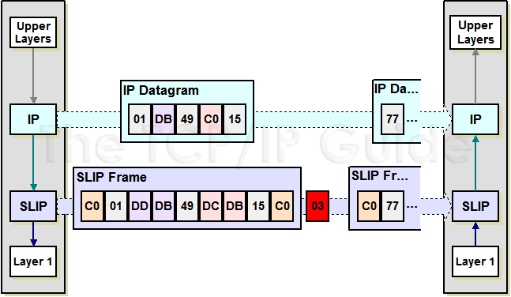
SLIP Protocol (2)

Slide 22
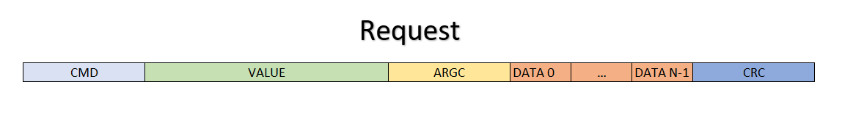
ESP-Link Frame Structure (1)
Sent from STM32
CMD = Command ID – 2 bytes
Value = Depend on CMD (Callback Address) – 4 bytes
ARGC = Argument Count – 2 bytes
=> Header len = 8 bytes
DATA 0 .. DATA N-1: Argument Data

Slide 23
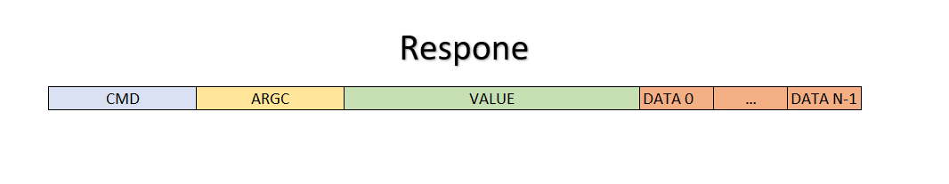
ESPLink Frame Structure (2)
Sent from ESP
CMD = Command ID (2 bytes)
ARGC = Argument Counts (2 bytes)
Value = Depend on CMD (Function Callback Address) ( 4 bytes)
DATA 0 .. DATA N-1: Argument Data Bytes

Slide 24
Argument Structure
Len H | Len L | Payload 0 |  |  | Payload n-1
Padding | Padding
2 bytes – Data Len
Multiple of 4 bytes

Slide 25
Reference Resources
1. Hướng dẫn cài đặt mosquito broker
https://m2msupport.net/m2msupport/install-mqtt-broker-mosquitto-in-windows/
2. MQTT protocol
https://m2msupport.net/m2msupport/how-mqtt-works/
3. SLIP Protocol
http://www.tcpipguide.com/free/t_SerialLineInternetProtocolSLIP-2.htm

Slide 26
THANK YOU!

